Slide 1
RETAIL SALES AND CUSTOMER ANALYTICS
Data Import, Understanding, Cleaning and Validation Using Python

Slide 2
Project Description
This project focuses on importing, examining, cleaning, validating and preparing a retail sales dataset for business and customer analytics. The work uses Python data-analysis techniques to understand the structure of the dataset, identify data-quality problems, correct invalid or inconsistent values, and prepare a clean dataset for subsequent analysis.
The dataset contains 2,000 retail transaction records. The analysis covers customer information, sales transactions, products, branches, pricing, quantities, discounts, costs and profits, together with other retail and customer-related variables visible in the project data.
The workflow begins with loading and examining the raw data, followed by missing-value analysis, duplicate validation, demographic validation, text standardization, data-type conversion, validation of unrealistic numerical values, outlier handling, and preparation of the cleaned dataset.

Slide 3
Project Structure
Section A: Data Import and Understanding
Section B: Data Cleaning and Validation

Slide 4
Section A: Data Import and Understanding
Questions
1-4

Slide 5
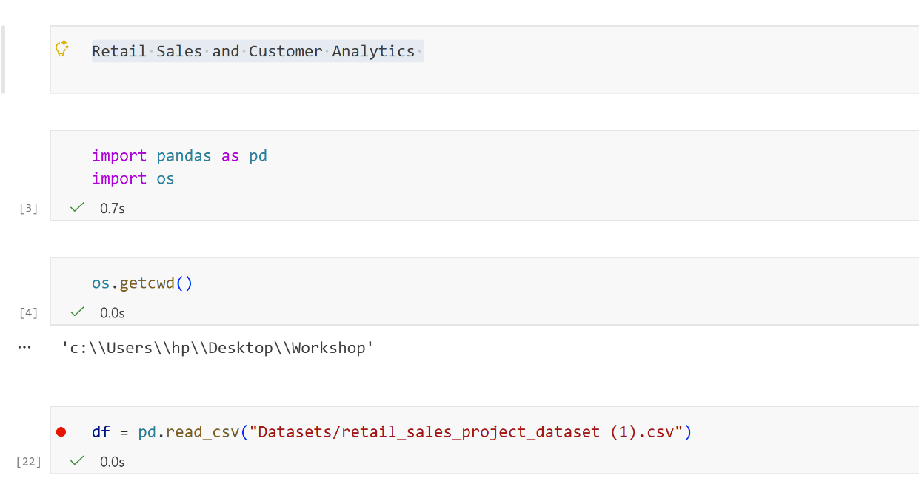
QUESTION 1: Import the retail sales dataset into Python and verify that the dataset has been loaded successfully.
Code
Key findings
The required Python libraries were successfully imported, allowing the dataset to be worked with.
The working directory was checked successfully, confirming where Python was looking for the dataset.
The retail sales CSV file was successfully loaded into a DataFrame called df, meaning the dataset was available for analysis.
The first five records were displayed successfully using df.head(), confirming that the dataset loaded correctly and contains retail sales information.

Slide 6
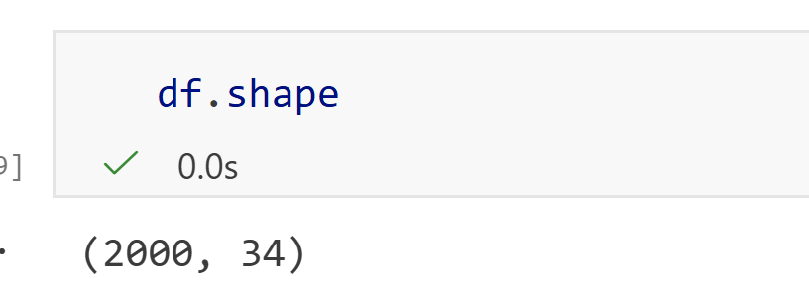
QUESTION 2: Examine the structure, dimensions, variables, and data types of the retail sales dataset.
Code;
Structure
Key findings
1. The dataset contains 2,000 rows, representing 2,000 records/transactions.
2. It contains 34 columns, representing 34 variables.
3. The dataset therefore has a fairly broad structure, with many variables available for customer, product, and sales analysis.

Slide 7
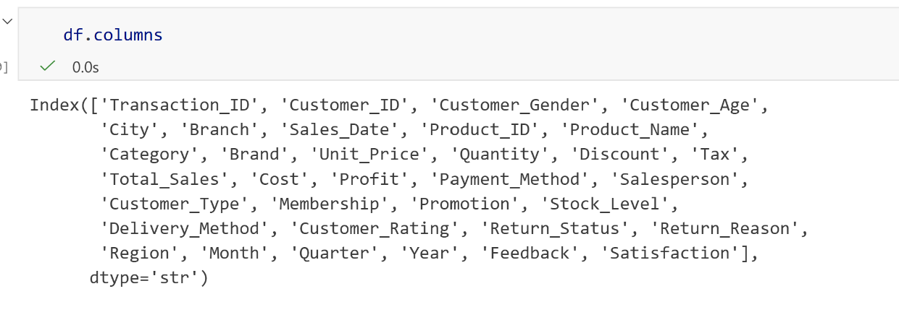
QUESTION 2(continuation): Examine the structure, dimensions, variables, and data types of the retail sales dataset.
Code:
Variables
Key findings
1. The output confirms that the dataset has 34 different variables.
2. The variables cover customer information, such as Customer_ID, Gender, Age and Customer_Type.
3. They also cover sales and financial information, including Unit_Price, Quantity, Total_Sales, Cost and Profit.
4. There are also product, payment, delivery, returns and customer-feedback variables.

Slide 8
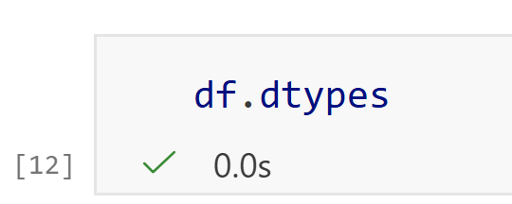
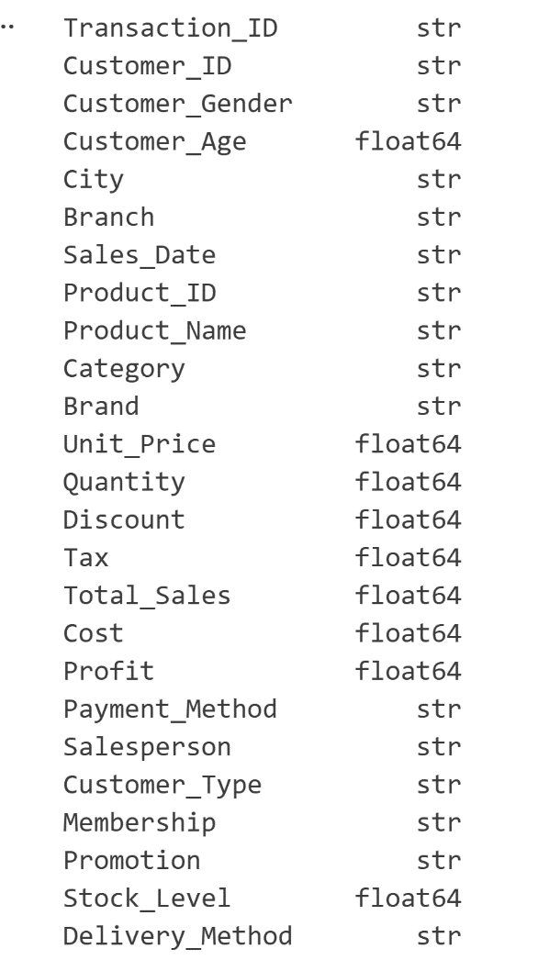
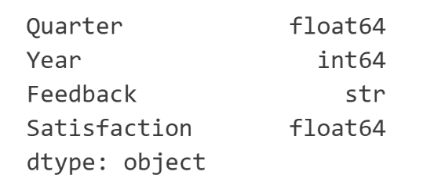
QUESTION 2(continuation): Examine the structure, dimensions, variables, and data types of the retail sales dataset.
Key findings
Text-based variables such as Transaction_ID, Customer_ID, City and Product_Name are stored as strings.
Numerical variables such as Customer_Age, Unit_Price, Quantity, Total_Sales, Cost and Profit are stored as float64.
Year is stored as an integer (int64).
The dataset also contains categorical/text information stored as object, such as Feedback and some other categorical fields.
The output shows that the dataset contains both categorical and numerical data, which allows different types of analysis to be performed..
Code
Data types

Slide 9
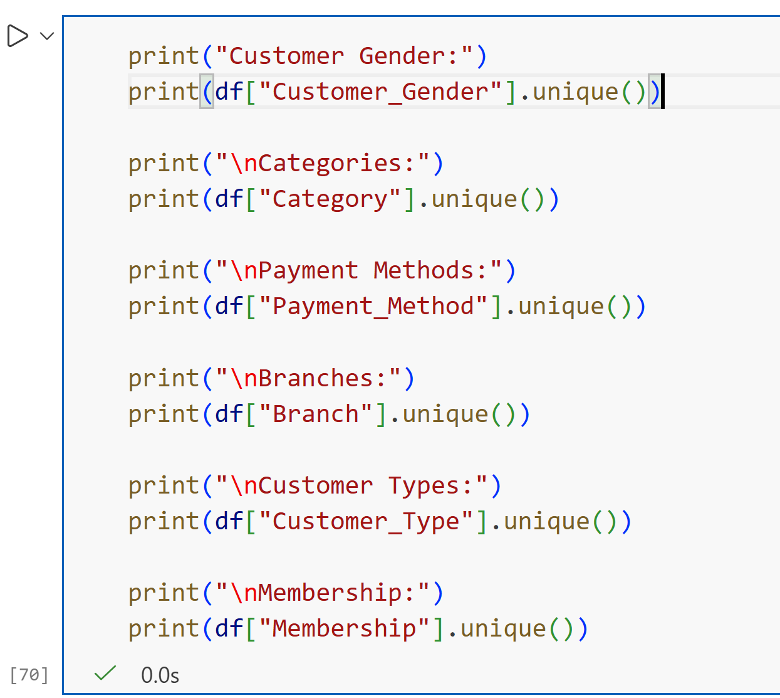
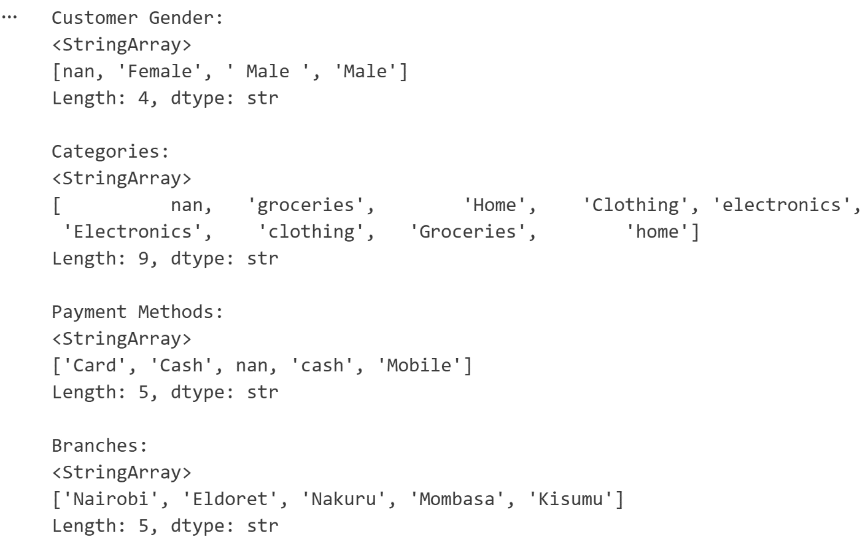
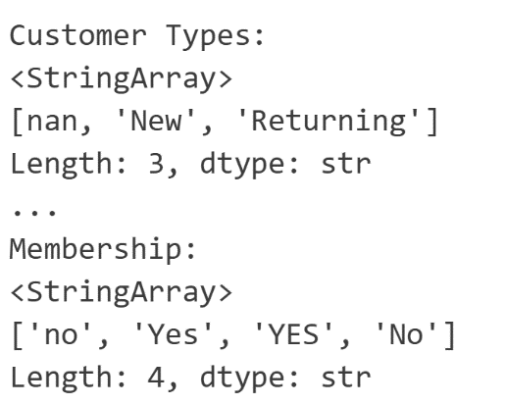
QUESTION 3: Explore the dataset to identify the different categories of variables available for analysis.
Code output
Key findings
1. Customer Gender has 4 distinct values: Female, Male, FEMALE, and Male, plus a missing value. This shows inconsistent gender entries.
2. Category has 9 distinct entries, including variations such as groceries and Groceries, as well as home and Home. This indicates inconsistent capitalization.
3. Payment Method has 5 values: Card, Cash, cash, Mobile, and a missing value. The Cash/cash difference shows another data inconsistency.
4. There are 5 branches: Nairobi, Eldoret, Nakuru, Mombasa, and Kisumu.
5. Customer Type has 3 categories: New, Returning, and a missing value. Membership also has inconsistent entries, including Yes/YES and No/no.

Slide 10
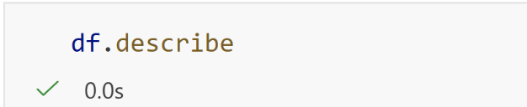
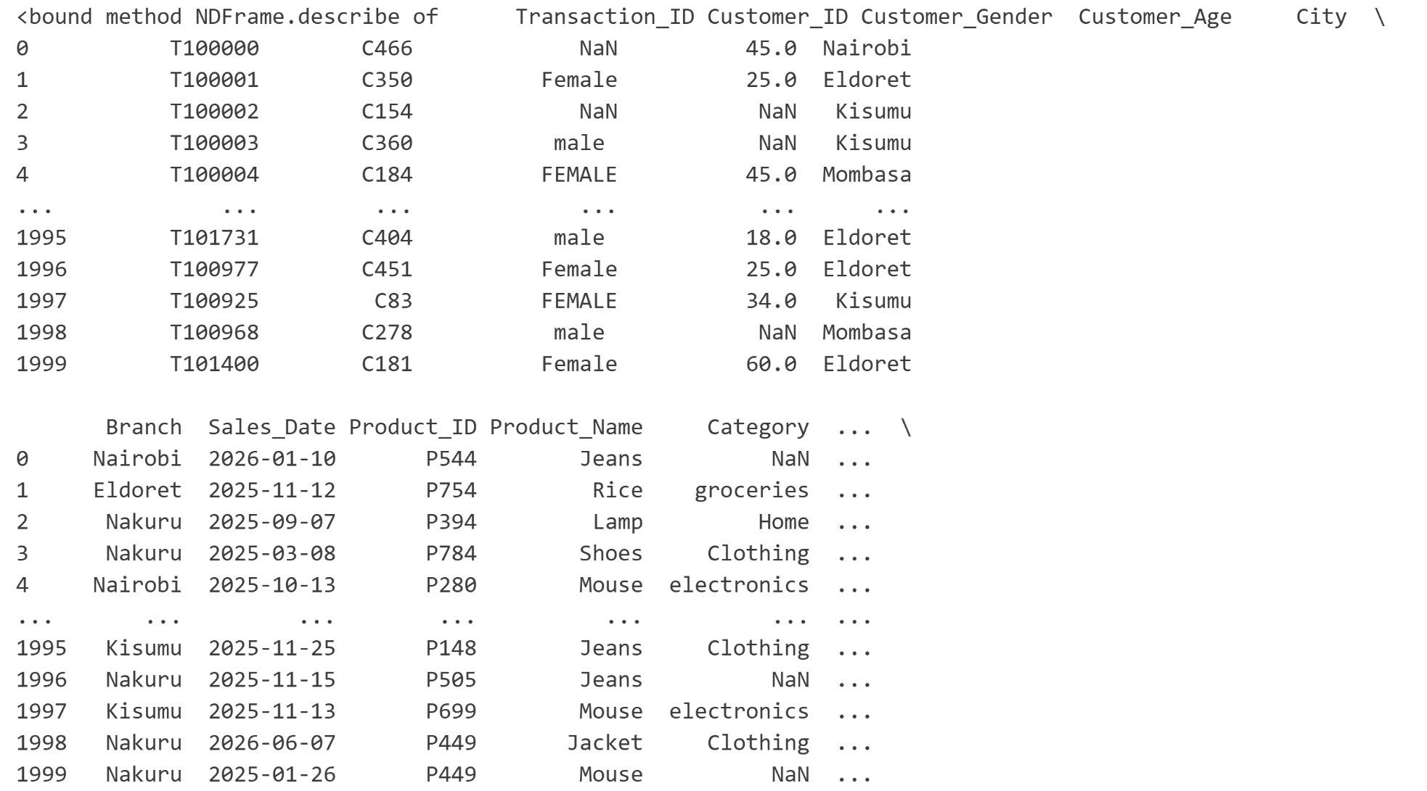
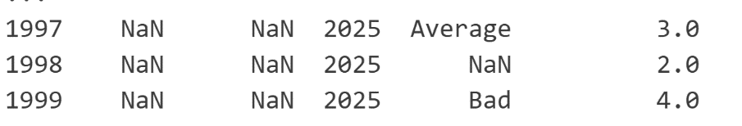
QUESTION 4: Produce descriptive summaries to gain an initial understanding of the dataset.
Code
Key findings
. 1. The dataset contains 2,000 transaction records, shown by the count of 2,000 for the numerical variables.
2. Customer ages vary considerably, with ages ranging from approximately 18 to 70 years in the displayed summary.
3. The average customer age is around the mid-40s, indicating that the dataset represents a broad range of adult customers.
4. The output shows variation in the numerical data, including differences between the minimum, maximum, and average values.
5. Some numerical fields contain missing values, shown where the output displays NaN, meaning those records are incomplete.

Slide 11
Section B: Data Cleaning and Validation
Questions
5-13

Slide 12
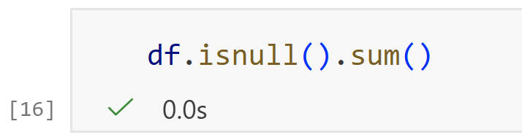
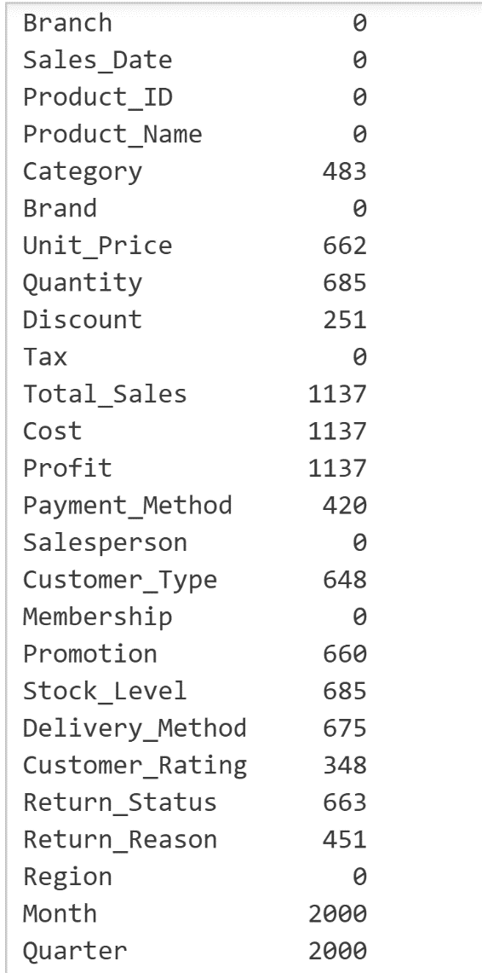
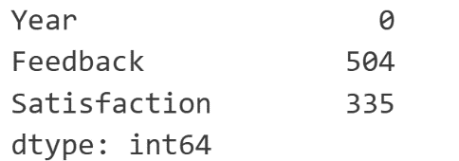
QUESTION 5: Clean and validate the retail sales dataset by identifying and correcting missing values using appropriate Python techniques.
Code
Key findings
Month and Quarter have the highest missing values, with 2,000 missing records each. This indicates these fields have the largest data gaps.
Total Sales, Cost, and Profit each have 1,137 missing values. This is important because these are key financial fields needed for sales analysis.
Quantity and Stock Level each have 685 missing values, while Unit Price has 662. These missing values can affect calculations involving products and inventory.
Several other fields also contain missing data, including Category (483), Customer Type (648), Payment Method (420), Return Status (663), and Feedback (504).
Some fields have no missing values at all, including Branch, Sales_Date, Product_ID, Product_Name, Brand, Tax, Salesperson, Membership, Region, and Year.

Slide 13
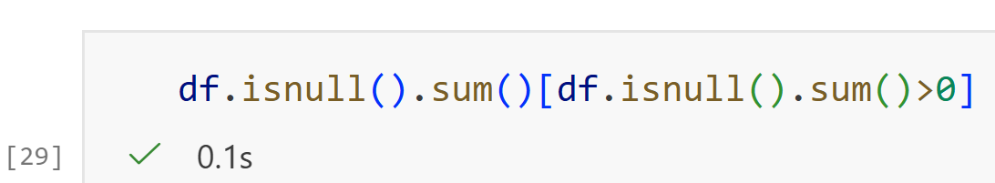
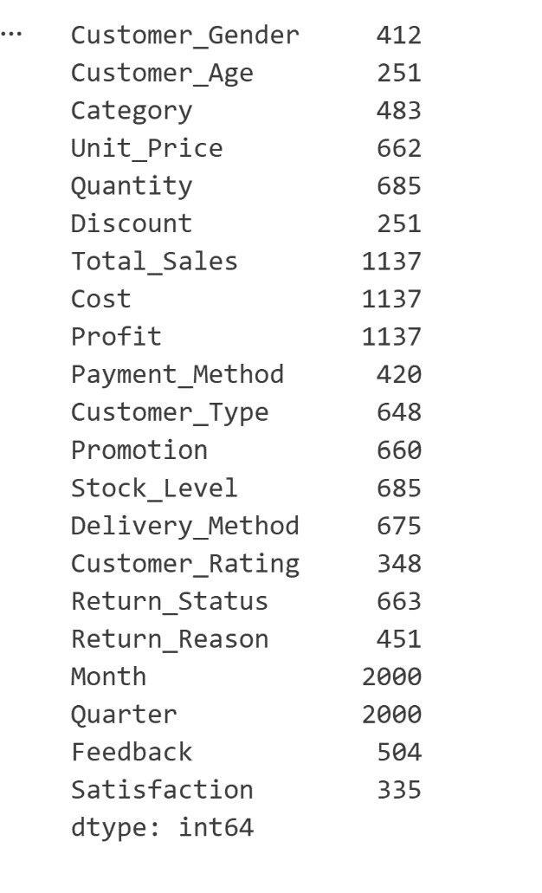
QUESTION 5(Continuation): Clean and validate the retail sales dataset by identifying and correcting missing values using appropriate Python techniques.
code
Key findings
1. The output now shows only columns that contain missing values; columns with 0 missing values have been excluded.
2. Month and Quarter have the highest number of missing values, with 2,000 missing records each.
3. Total Sales, Cost, and Profit each have 1,137 missing values, indicating substantial gaps in the financial information.
4. Quantity and Stock Level each have 685 missing values, while Delivery Method has 675.
5. Customer information also has missing records, including Customer Type (648), Customer Gender (412), and Customer Satisfaction (335).

Slide 14
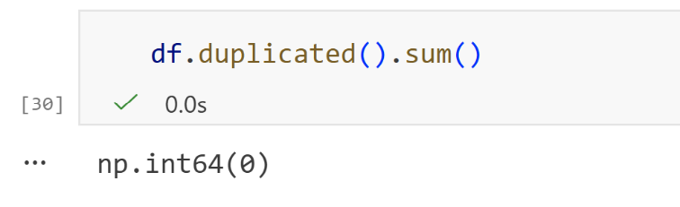
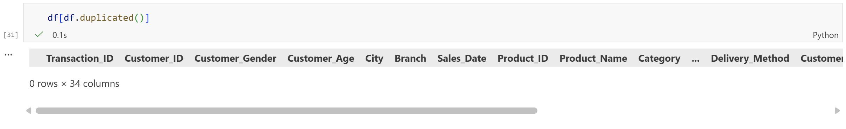
QUESTION 6: Identify, validate, and remove duplicate transaction records while preserving valid sales information.
Code
Key findings
There are 0 duplicate transaction records in the dataset.
No duplicate transactions were found, so there are no repeated records affecting the sales data.
All transaction records are unique, meaning the existing sales information can be retained without removing any duplicate records.

Slide 15
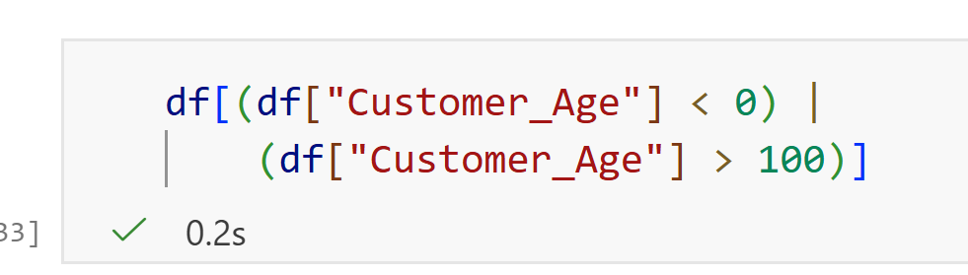
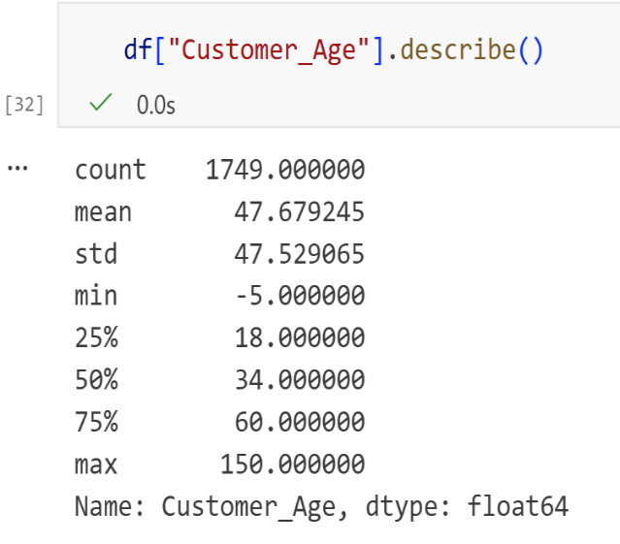
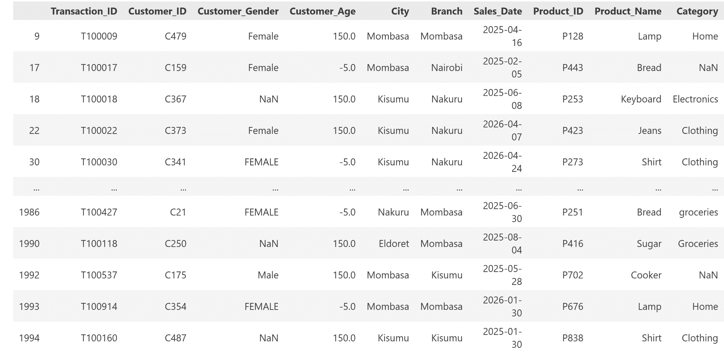
QUESTION 7: Validate customer demographic information by identifying invalid ages and inconsistent customer categories.
Code
Key findings
Check customer ages
  describe() summarizes the Customer_Age column.
  It shows the minimum age is -5 and the maximum is 150.
Identify invalid ages
  Ages below 0 or above 100 are considered invalid.
  Examples in the data include -5 and 150.
Display invalid records
  The filtering condition identifies customers whose ages are outside the valid range.
  This helps us locate the records that need to be corrected or handled.
Purpose
  Validating ages improves the accuracy and reliability of customer demographic analysis.

Slide 16
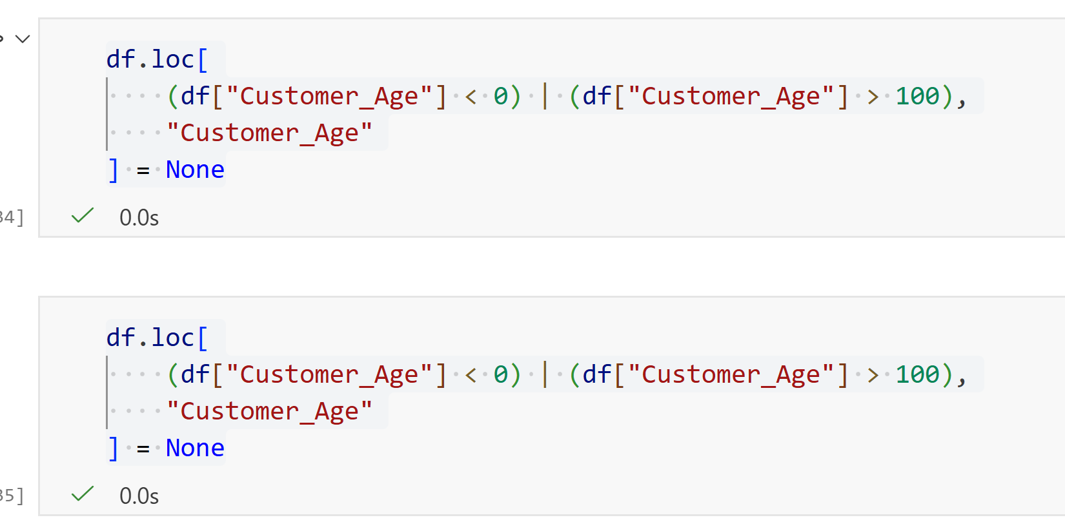
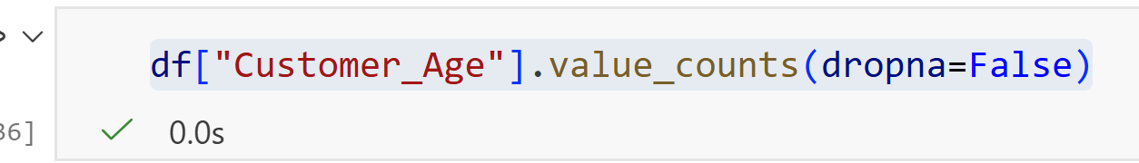
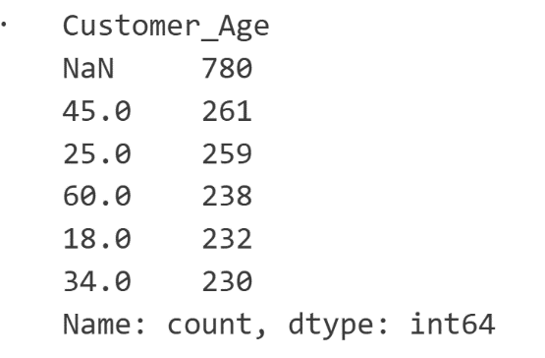
QUESTION 7(Continuation): Validate customer demographic information by identifying invalid ages and inconsistent customer categories.
Code
Key findings
The analysis checks for invalid customer ages below 0 or above 100.
The output does not show any invalid age values, so there are no ages outside the expected 0–100 range in the displayed result.
However, there are 780 missing age values (NaN).
The most common recorded ages include:
  45 years — 261 customers
  25 years — 259 customers
  60 years — 238 customers
  18 years — 232 customers
  34 years — 230 customers

Slide 17
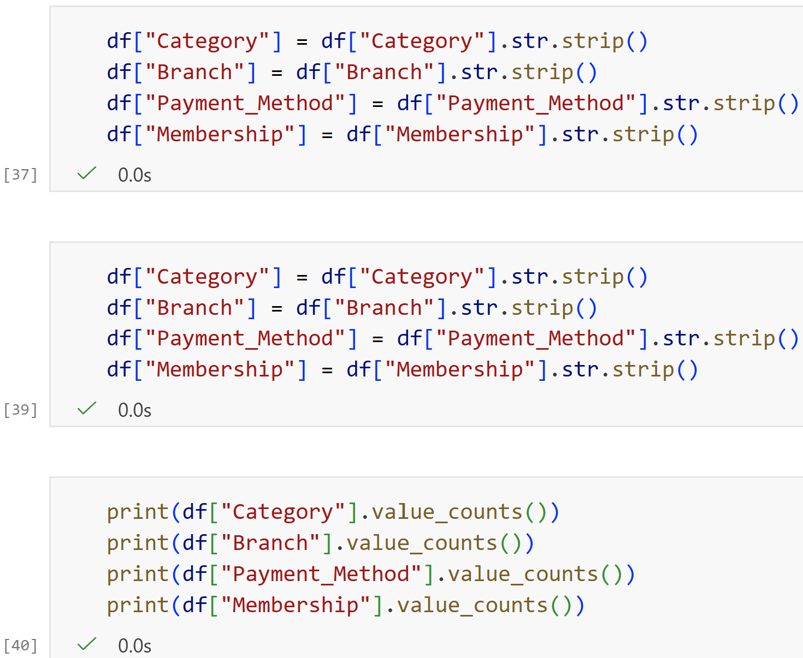
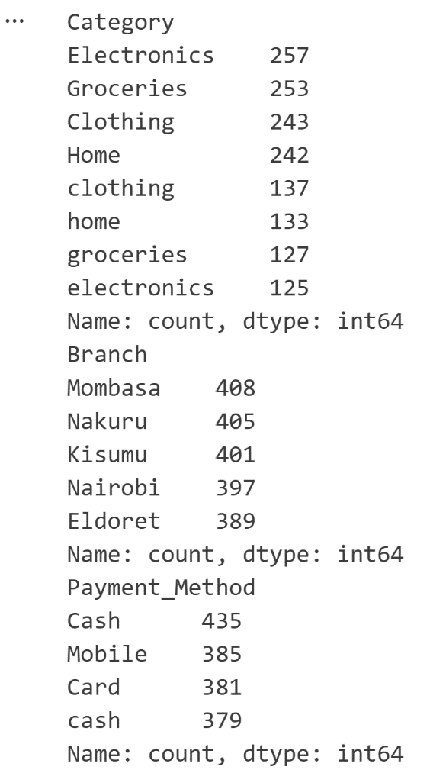
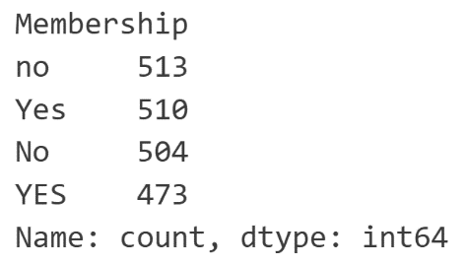
QUESTION 8: Standardize product categories, branch names, payment methods, and customer membership information.
Code
Key Findings
The dataset contains inconsistent formatting in the categorical columns.
Category:
  Clothing = 243
  clothing = 137
  Home = 242
  home = 133
  Groceries = 253
  groceries = 127
  Electronics = 257
  electronics = 125
This shows that the same categories were being treated as separate values because of capitalization.
Payment Method also has inconsistent capitalization:
  Cash = 435
  cash = 379
Membership has similar inconsistencies:
  Yes = 510
  YES = 473
  No = 513
  NO = 504
Branch names appear consistently formatted in the output.

Slide 18
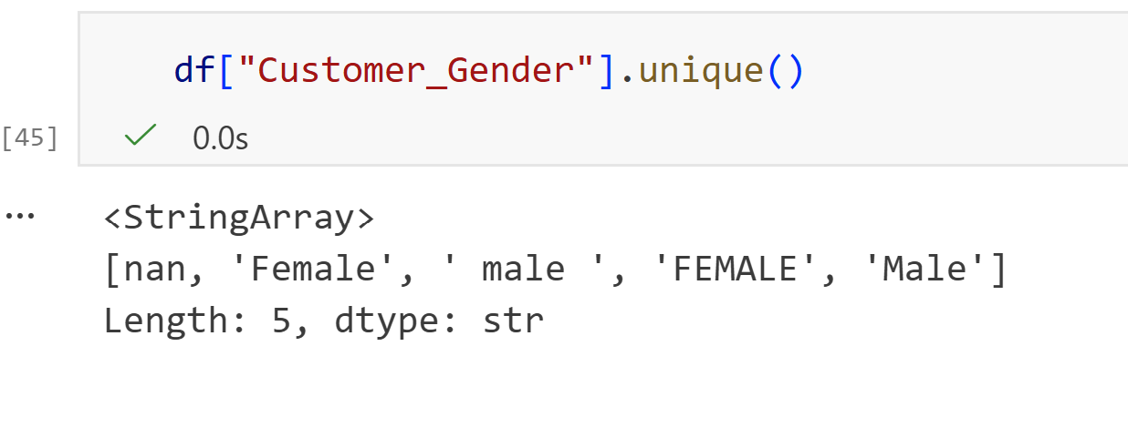
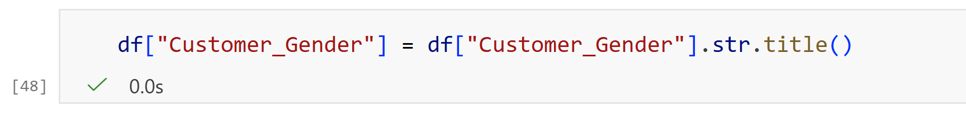
QUESTION 9: Detect and correct inconsistent text formatting including unnecessary spaces, mixed letter cases, and spelling inconsistencies.
Code
Key findings
The dataset had inconsistent capitalization for gender values.
male and Male represent the same category but were stored differently.
Female and FEMALE also represent the same category but had different capitalization.
Missing values (NaN) were also present.
After standardizing the text using .str.title(), values such as male → Male and FEMALE → Female become consistent.

Slide 19
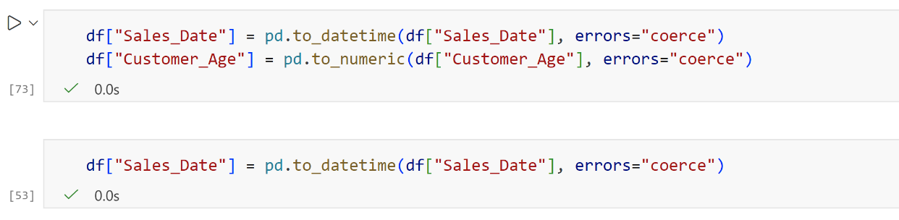
QUESTION 10: Convert variables into appropriate data types suitable for business analysis.
Code
Key findings
Sales_Date was converted to a datetime data type.
  This allows the sales data to be analyzed by day, month, quarter, or year.
Customer_Age was converted to a numeric data type.
  This allows us to perform calculations such as average age, minimum age, maximum age, and comparisons.
Invalid values that could not be converted were changed to missing values (NaN) because errors="coerce" was used.

Slide 20
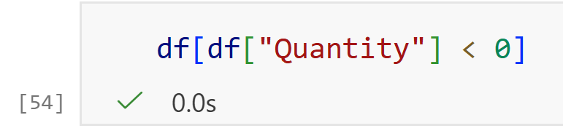
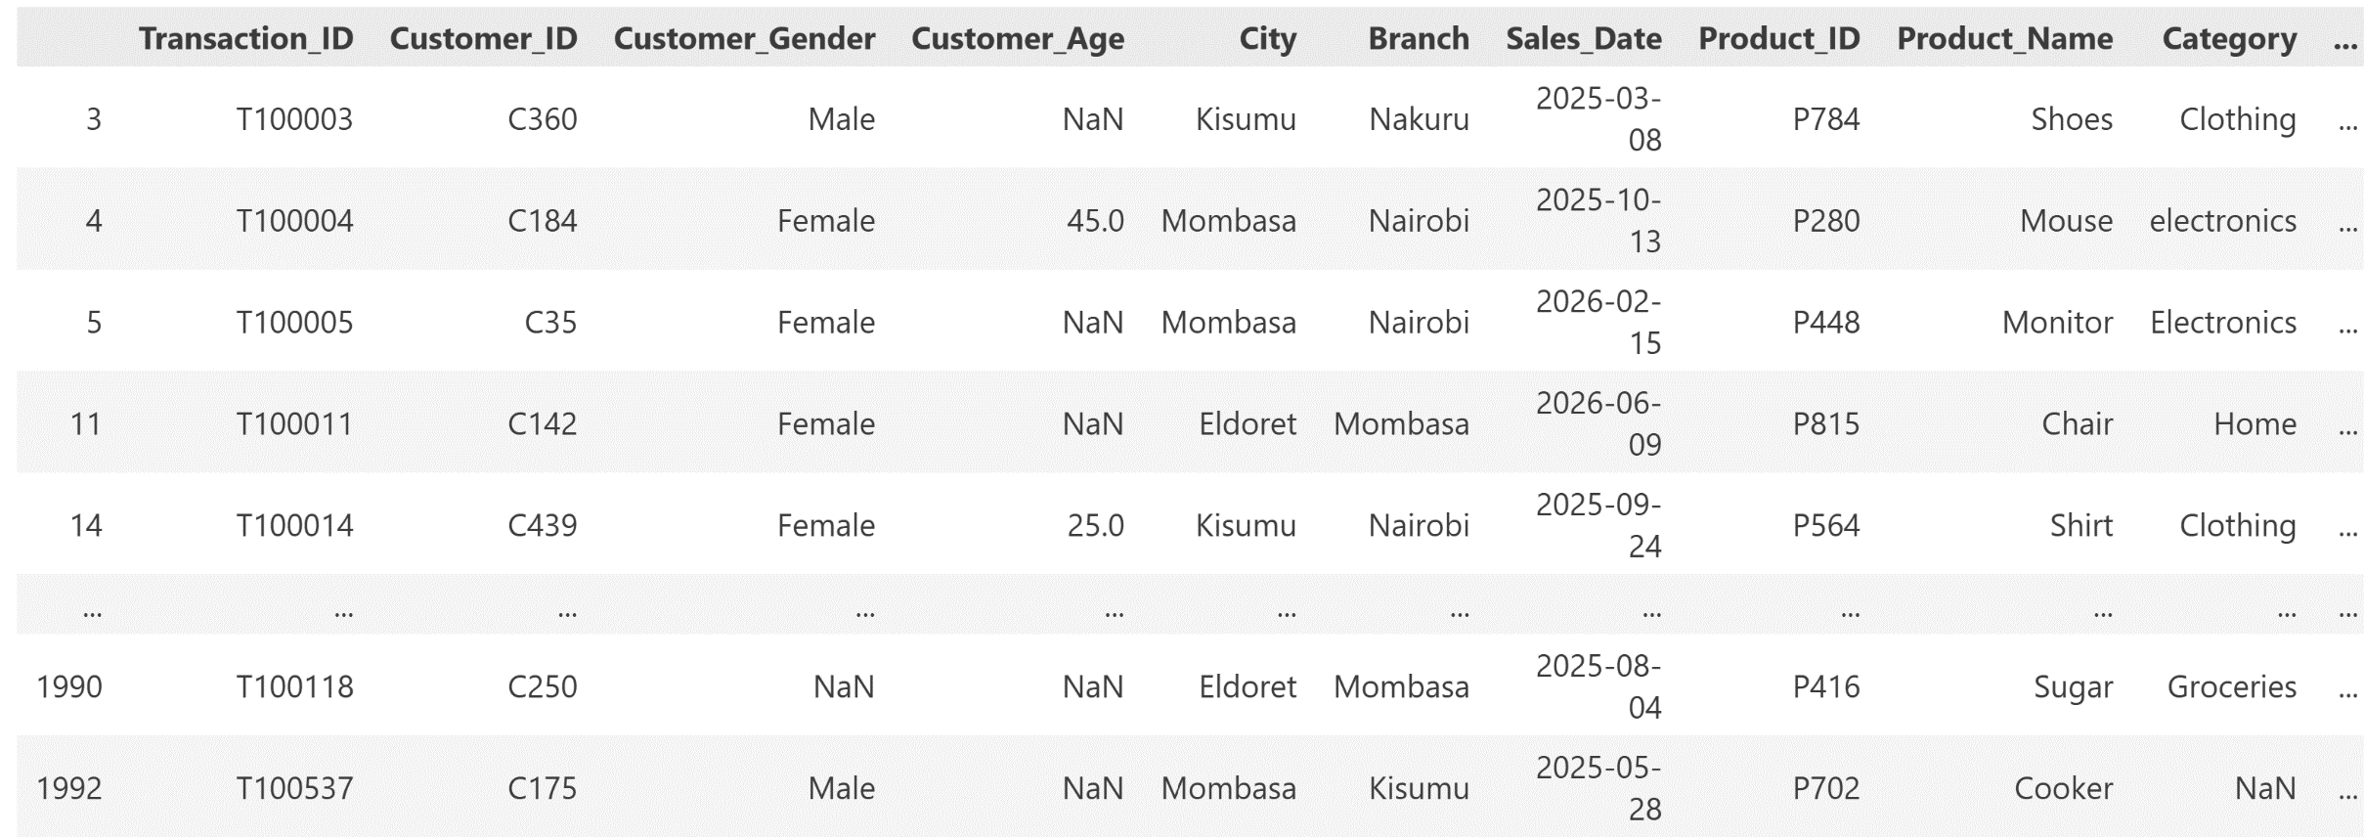
QUESTION 11: Identify and validate unrealistic numerical values such as negative quantities, incorrect discounts, invalid unit prices, and unrealistic profits.
Key findings
Code
Negative quantities were identified in the dataset.
Several transactions contain quantities below zero.
Negative quantities are unrealistic for normal sales transactions.
These values may indicate data-entry or data-quality errors.
The affected records should be investigated and validated before further analysis.

Slide 21
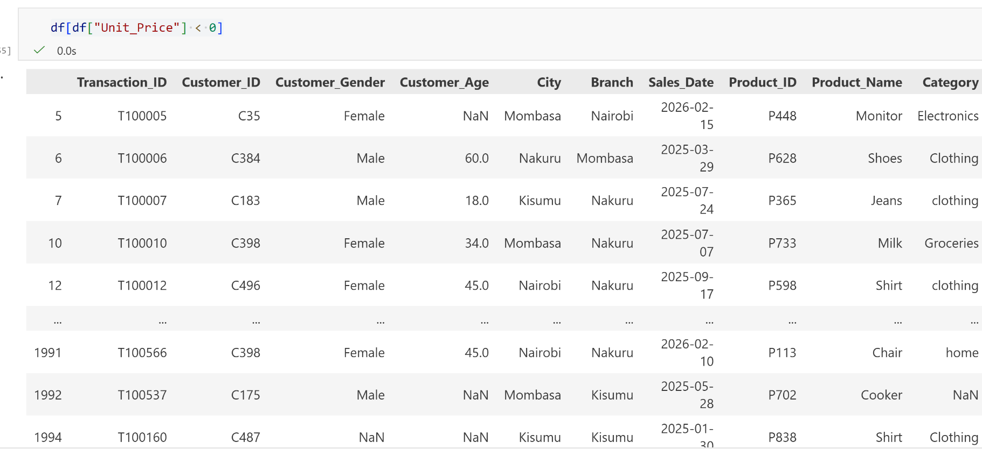
QUESTION 11(Continuation): Identify and validate unrealistic numerical values such as negative quantities, incorrect discounts, invalid unit prices, and unrealistic profits.
Code
Key findings
Negative unit prices were identified in the dataset.
Several transactions contain unit prices below zero.
A negative unit price is unrealistic for a normal sales transaction.
These values may indicate data-entry or data-quality errors.
The affected records should be investigated and validated before further analysis.

Slide 22
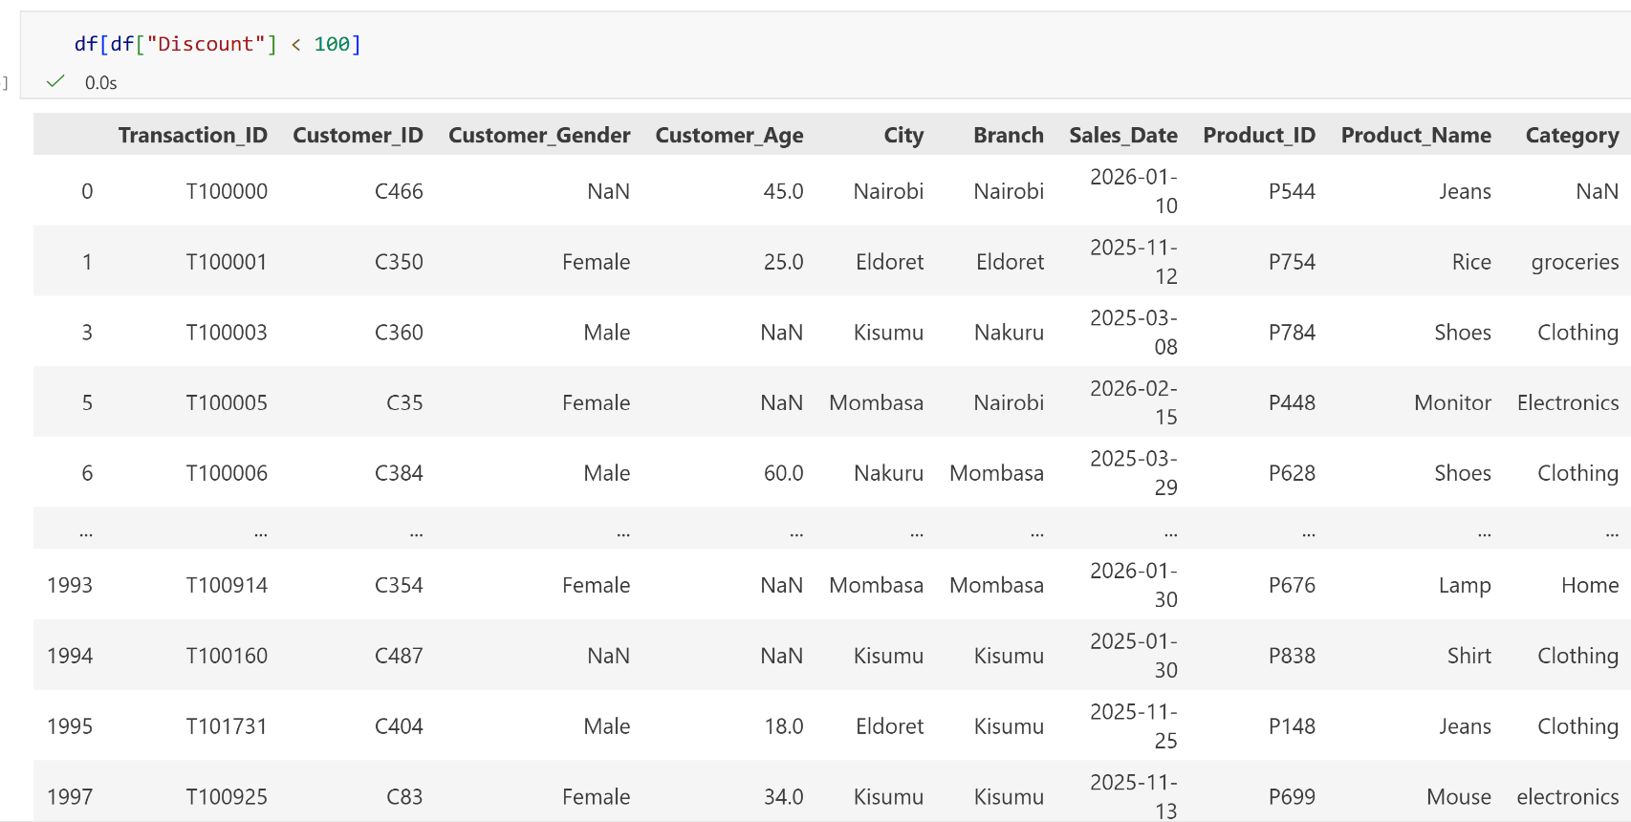
QUESTION 11(Continuation): Identify and validate unrealistic numerical values such as negative quantities, incorrect discounts, invalid unit prices, and unrealistic profits.
Code
Key findings
Invalid discount values were identified in the dataset.
The discount range includes a value of 110%.
A discount above 100% is unrealistic for a normal sales transaction.
This indicates a potential data-quality or data-entry error.
The affected records should be investigated and validated before further analysis.sales calculations.

Slide 23
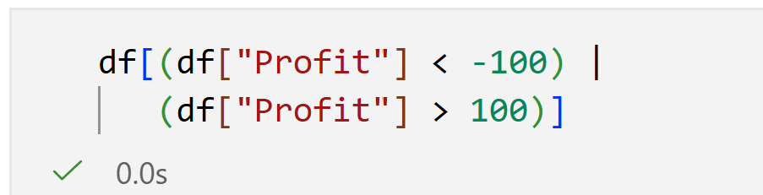
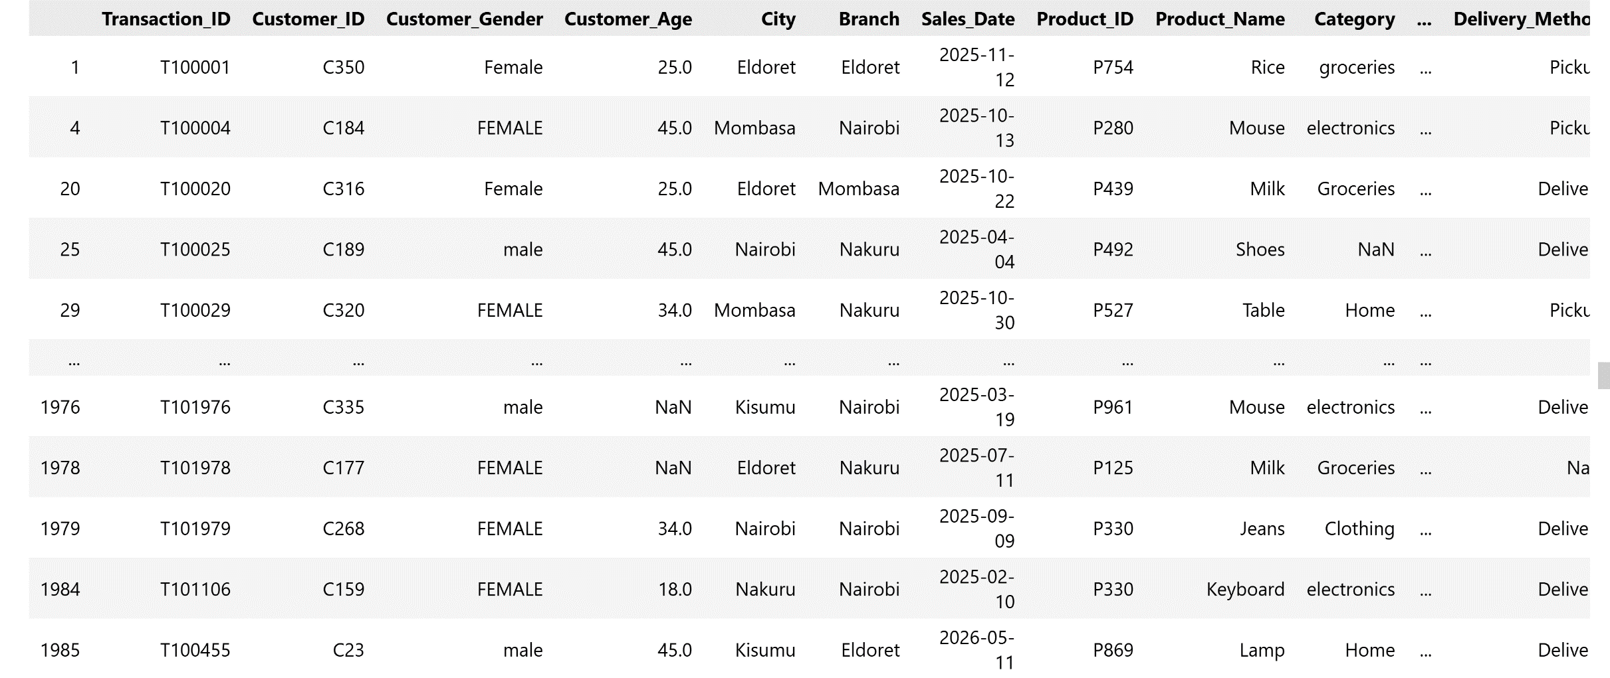
QUESTION 11(Continuation): Identify and validate unrealistic numerical values such as negative quantities, incorrect discounts, invalid unit prices, and unrealistic profits.
code
Key findings
Extreme profit values were identified in the dataset.
Some transactions recorded profits below −100, representing substantial losses.
Other transactions recorded profits above 100, representing unusually high profits.
The analysis identified 297 transactions within these extreme ranges.
These values may represent genuine unusual transactions or potential outliers.
The affected records should be validated before further analysis.

Slide 24
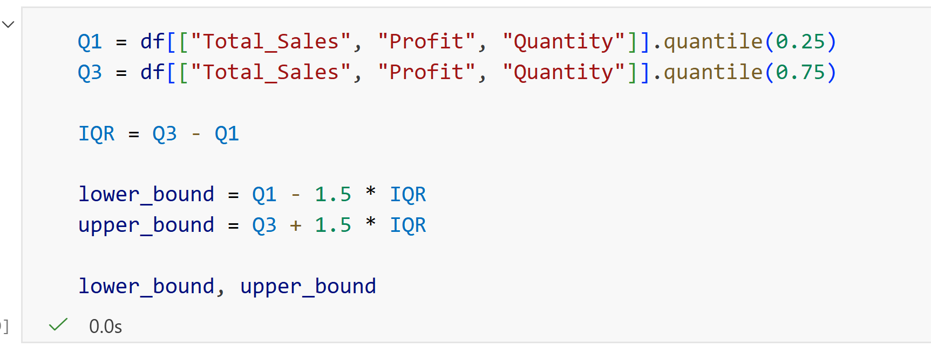
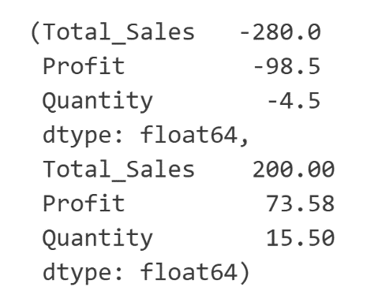
QUESTION 12: Detect and appropriately handle outliers in sales, profit, and quantity variables
Code
Key findings
Total Sales: The acceptable range is approximately -280 to 200.
  → Values above 200 are considered potential outliers.
Profit: The acceptable range is approximately -98.5 to 73.58.
  → Profits above 73.58 or below -98.5 may be outliers.
Quantity: The acceptable range is approximately -4.5 to 15.5.
  → Quantities above 15.5 may be considered outliers. Since quantity normally cannot be negative, the negative lower boundary is mainly a mathematical result of the IQR method.

Slide 25
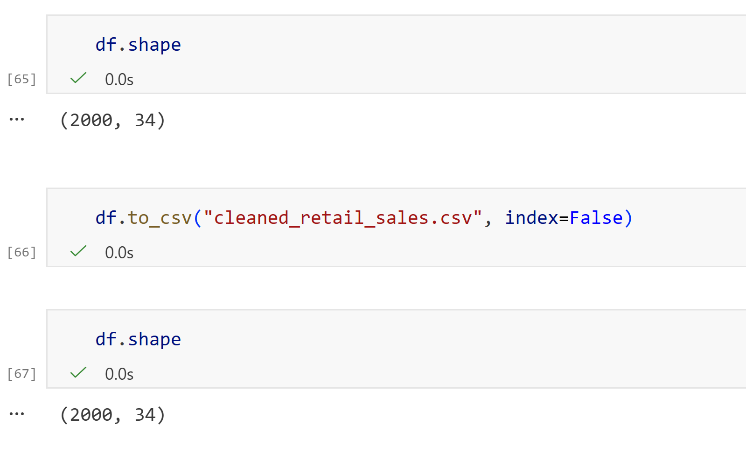
QUESTION 13: Produce a cleaned and validated retail sales dataset and export it as a new CSV file
code
Key findings
1. The cleaned dataset still contains 2,000 records and 34 variables, so the cleaning process did not remove the dataset's overall structure.
2. The cleaned dataset was successfully exported as a new CSV file named cleaned_retail_sales.csv.
3. No extra index column was added to the exported file, keeping the dataset structure clean.
4. The cleaned file is ready for reuse, such as opening, sharing, or using it for further analysis.

Slide 26
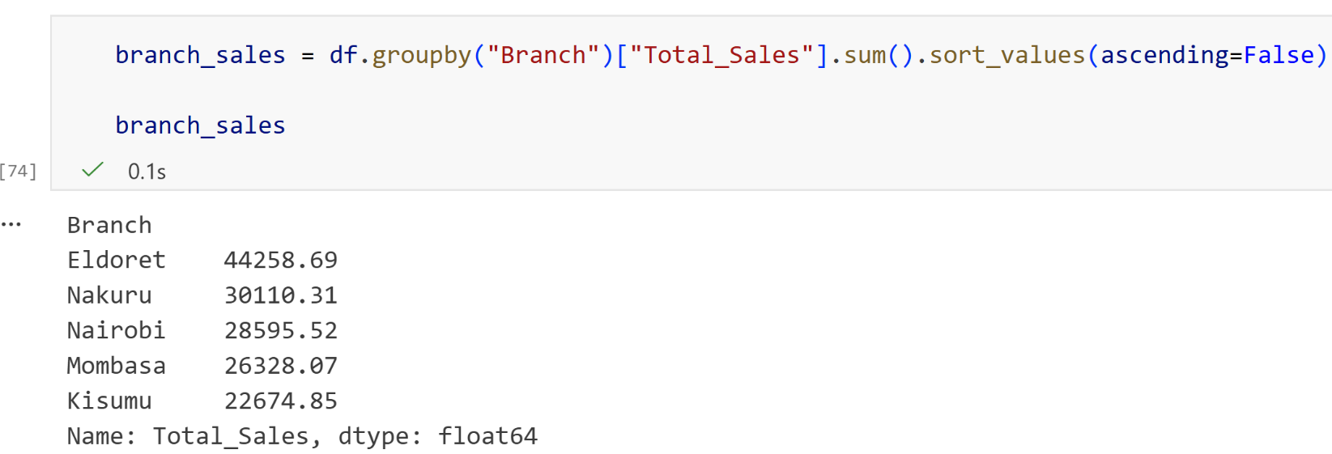
Question 14: Analyze sales performance across different branches.
code
Key findings
Eldoret recorded the highest total sales at 44,258.69.
Nakuru ranked second with 30,110.31 in total sales.
Nairobi followed with 28,595.52.
Mombasa recorded 26,328.07.
Kisumu had the lowest total sales at 22,674.85.

Slide 27
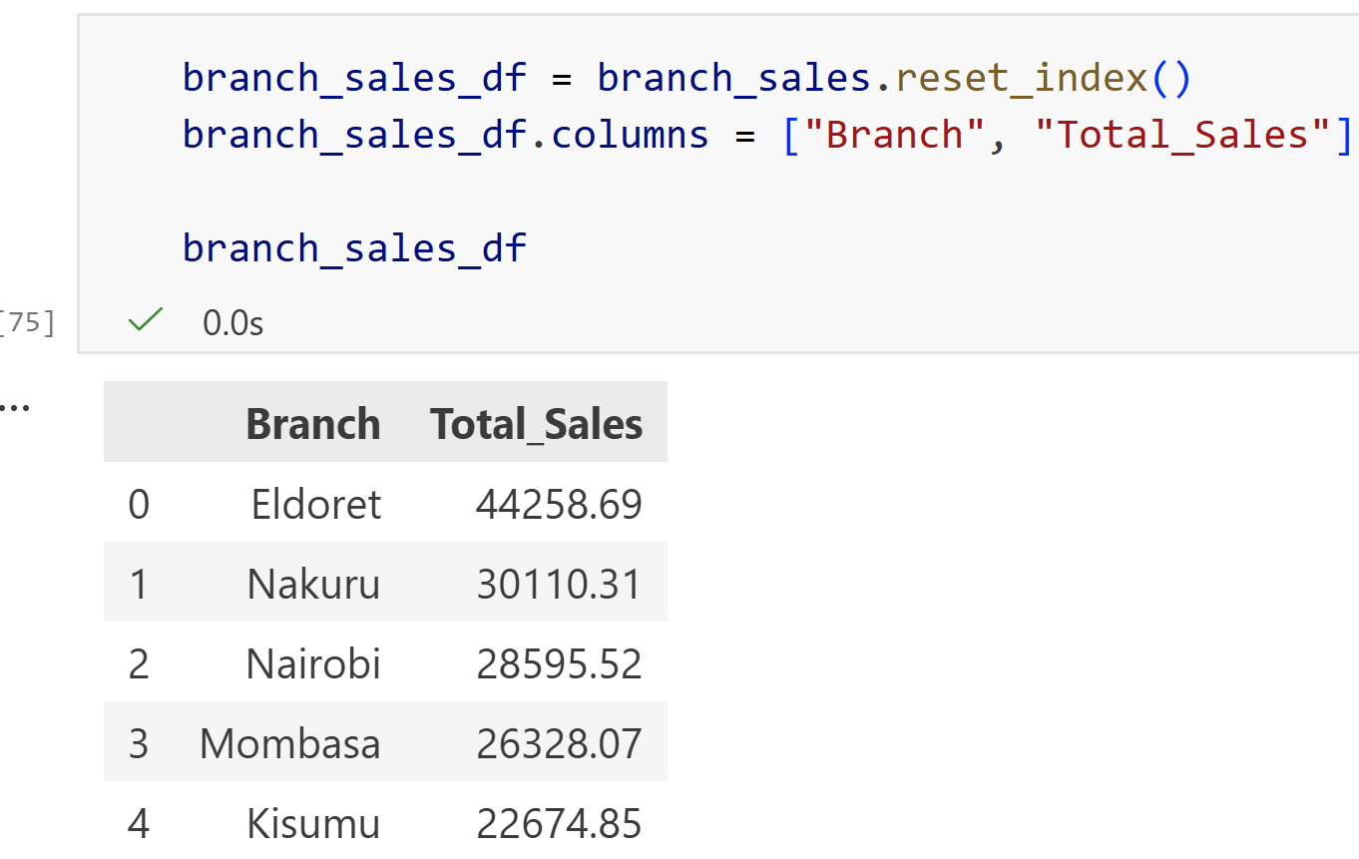
Question 14: Analyze sales performance across different branches.
code
Key findings
Eldoret recorded the highest total sales at 44,258.69.
Nakuru ranked second with 30,110.31 in total sales.
Nairobi followed with 28,595.52.
Mombasa recorded 26,328.07.
Kisumu had the lowest total sales at 22,674.85.

Slide 28
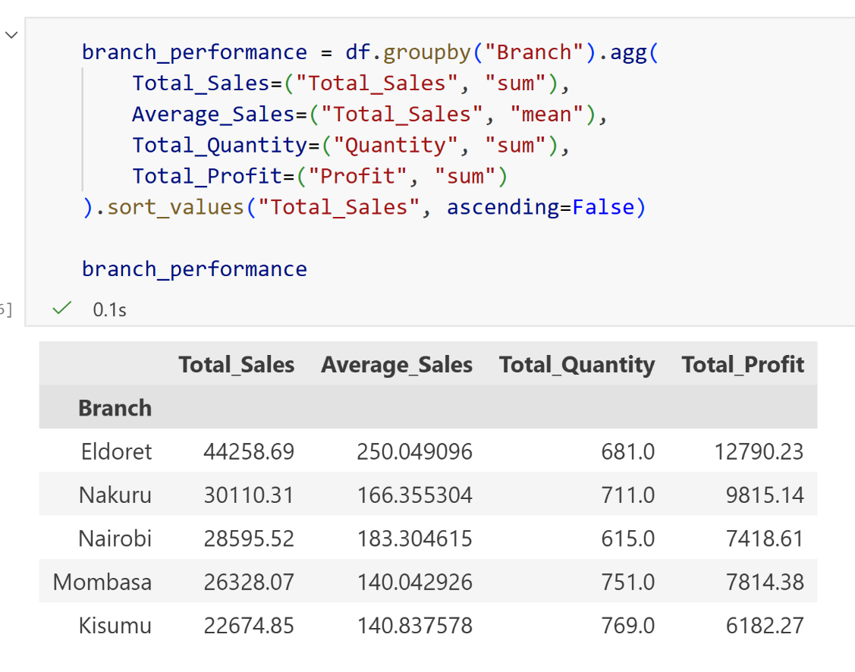
Question 14: Analyze sales performance across different branches.
Key findings
Code
Eldoret generated the highest total sales at 44,258.69 and also recorded the highest average sales (250.05) and highest profit (12,790.23).
Nakuru ranked second in total sales (30,110.31) and generated 9,815.14 in profit.
Nairobi had 28,955.52 in total sales and 7,418.61 in profit.
Mombasa recorded 26,328.07 in sales and had the highest quantity sold among the first four branches (751).
Kisumu had the lowest total sales (22,674.85) and lowest profit (6,182.27), although it recorded the highest quantity sold (769).
Overall, Eldoret leads in sales and profitability, while Kisumu sells the most units but generates the lowest total sales and profit.
Eldoret — 44,258.692.
Nakuru — 30,110.313.
Nairobi — 28,955.524.
Mombasa — 26,328.075.
Kisumu — 22,674.85

Slide 29
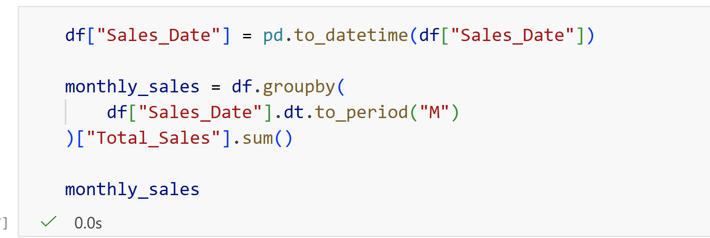
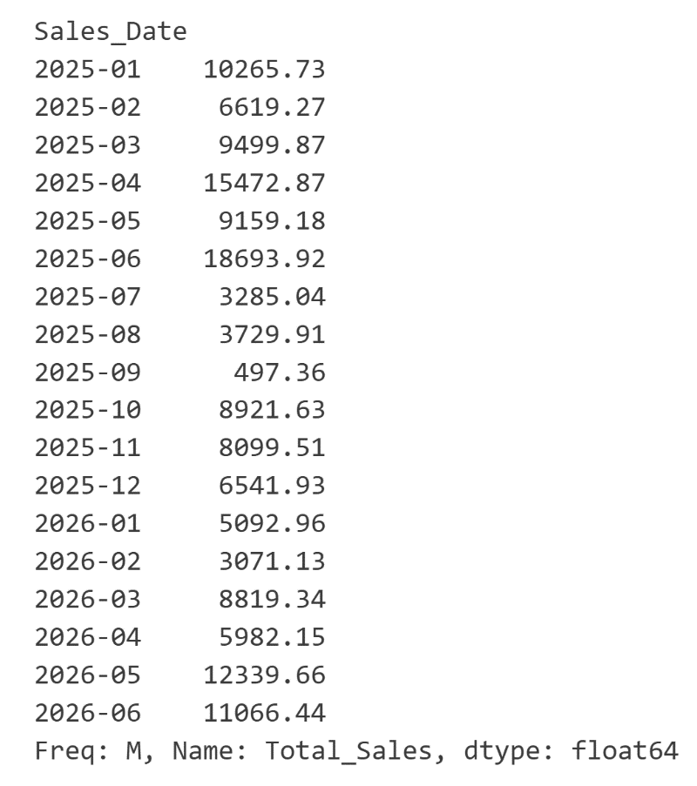
Question 15: Analyze monthly and quarterly sales trends.
Key findings
Code
June 2025 had the highest monthly sales, with 18,693.92.
September 2025 had the lowest monthly sales, with only 497.36.
Sales increased strongly from Q1 to Q2 2025, reaching the highest quarterly sales of 43,325.97.
Sales dropped significantly in Q3 2025 to 7,512.31, before recovering in Q4 2025 to 23,563.07.
In 2026, Q2 sales (29,390.25) were higher than Q1 sales (16,983.43), showing an improvement.
Overall, the sales pattern shows significant fluctuations, with some months and quarters performing much better than others.

Slide 30
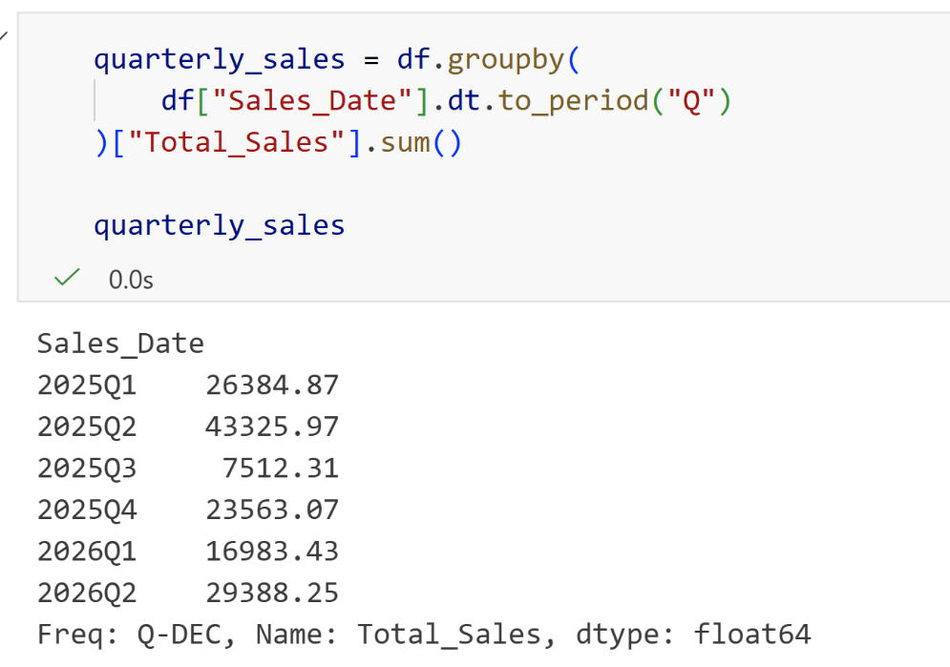
Question 15: Analyze monthly and quarterly sales trends.
code
Key findings
2025 Q2 recorded the highest total sales, at 43,325.97.
2025 Q3 recorded the lowest total sales, at 7,512.31.
Sales increased sharply from 26,384.87 in 2025 Q1 to 43,325.97 in Q2, before falling to 7,512.31 in Q3.
Sales recovered in 2025 Q4, reaching 23,563.07
.In 2026, sales increased from 16,983.43 in Q1 to 29,388.25 in Q2.
Overall, the results show significant fluctuations in quarterly sales, with the strongest performance in 2025 Q2 and the weakest in 2025 Q3.

Slide 31
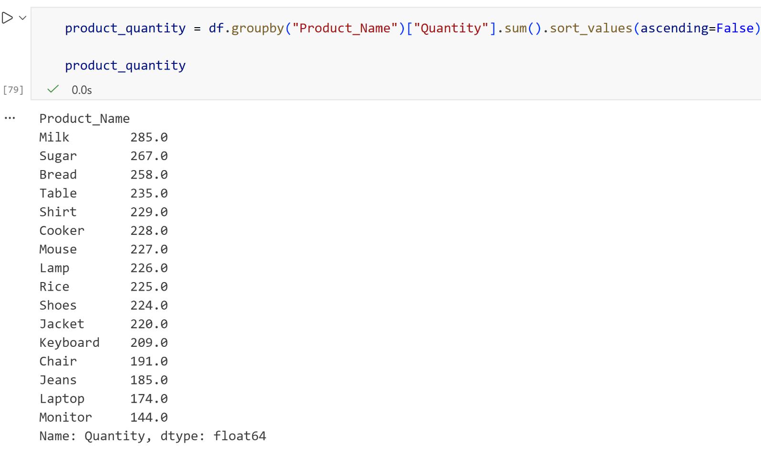
Question 16: Determine the best-selling products based on quantity sold.
Code
Key findings
Milk is the best-selling product, with 285 units sold.
Sugar ranks second, with 267 units sold.
Bread ranks third, with 258 units sold.
Table follows with 235 units, while Shirt has 229 units.
Monitor has the lowest quantity sold among the products shown, with 144 units.
The results show a clear difference in the quantities sold across the products, with Milk having the highest demand.

Slide 32
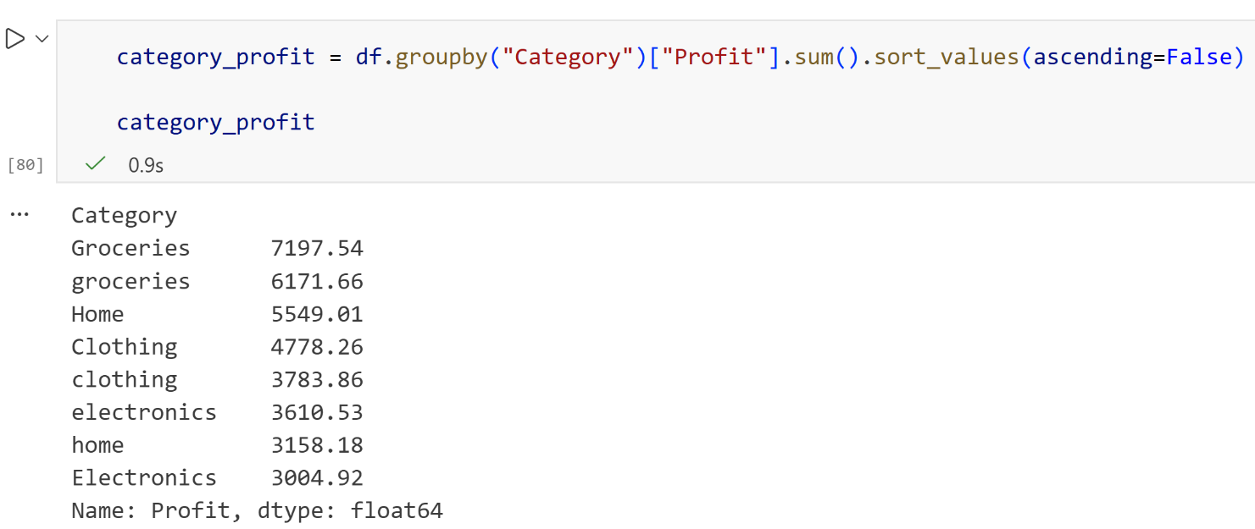
Question 17: Determine the Most Profitable Product Categories
Key findings
Code
Groceries has the highest total profit, at 7,197.54.
The second groceries category generated 6,171.66.
Home generated 5,549.81, while Clothing generated 4,778.26.
The other category entries recorded profits ranging from 3,158.18 to 3,804.92.
The results show that Groceries contributes the highest profit among the categories shown.
The output contains categories with different capitalization, such as “Groceries” and “groceries”, which are treated as separate categories.

Slide 33
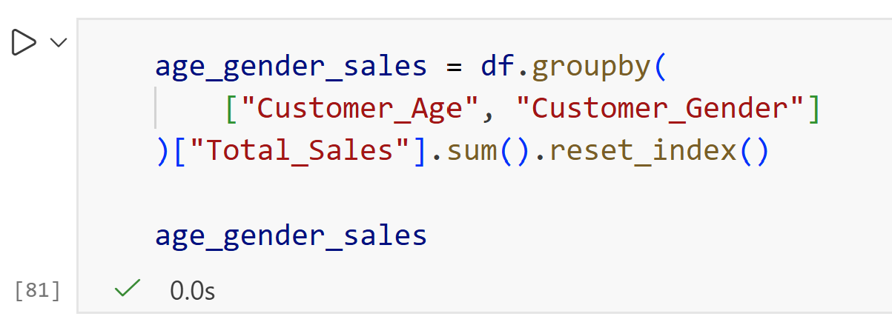
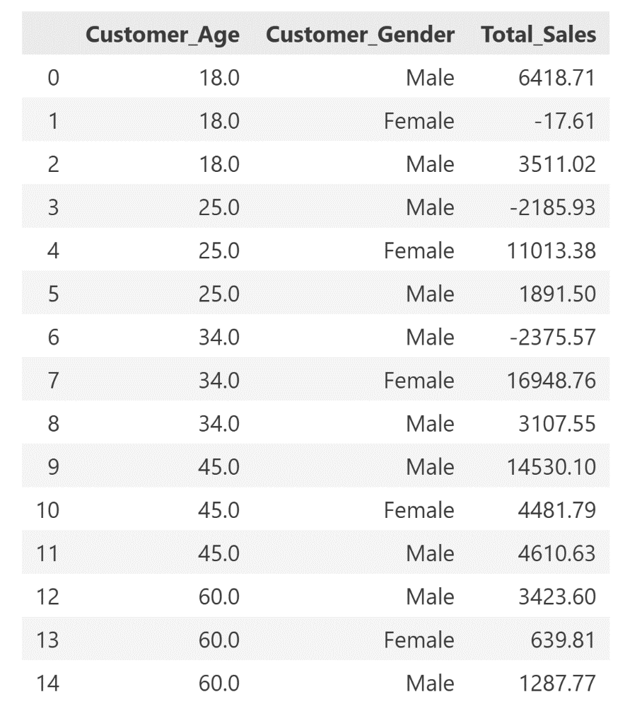
Question 18: Analyze Customer Purchasing Behavior Based on Age and Gender
Code
Key findings
Female customers aged 34 generated the highest total sales, at 16,948.76.
Male customers aged 45 generated the second-highest total sales, at 14,530.10.
Female customers aged 25 generated 11,013.38 in total sales.
Some customer groups recorded negative total sales, such as male customers aged 34 (-2,375.57) and male customers aged 25 (-2,185.93).
The results show that purchasing levels differ across age and gender groups, with the 34-year-old female group contributing the highest sales in the displayed results.

Slide 34

Question 19: Compare Sales Generated by Different Payment Methods
Code
Key findings
Cash generated the highest total sales: 49,298.28.
Cash was followed by cash with 29,896.92.
Mobile generated 23,965.99 in total sales.
Card generated the lowest total sales: 23,868.69.
The difference between the highest and lowest payment methods is 25,429.59.
The results show a clear difference in total sales generated across the payment methods.

Slide 35

Question 20: Analyze Customer Satisfaction Ratings Across Branches
Code
Key findings
Eldoret has the highest average customer rating: 3.1625.
Nairobi ranks second: 3.0876.
Kisumu ranks third: 3.0395.
Mombasa ranks fourth: 2.8780.
Nakuru has the lowest average customer rating: 2.8393.
The results show that customer satisfaction varies across the branches, with Eldoret recording the highest average rating and Nakuru the lowest.

Slide 36

Question 21: Determine the Impact of Promotional Campaigns on Sales Performance
code
Key findings
Sales with a promotion generated 61,202.40 in total sales.
Sales without a promotion generated 44,099.97.
The difference is 17,102.43, meaning promoted sales were substantially higher in total.
Promoted transactions accounted for approximately 58.1% of the combined sales shown.
The output shows that sales were higher for transactions where a promotion was applied.

Slide 37

Question 22: Analyze the Relationship Between Discounts and Total Sales
code
Key findings
The 10% discount generated the highest total sales at 25,909.26.
The 0% discount generated the second-highest total sales at 25,410.82.
The 20% discount generated 18,137.74 in total sales.
The 15% discount generated 17,271.27.The 5% discount generated the lowest total sales at 3,586.86.
Overall, the output shows that 10% and 0% discount levels generated the highest total sales, while 5% generated the lowest.

Slide 38

Question 23: Analyze Return Patterns and Common Return Reasons
Code
Key findings
671 transactions were not returned, while 666 transactions were returned.
The number of returned and non-returned transactions is almost equal, showing a relatively balanced return pattern.
Returned transactions represent approximately 49.8% of all transactions.
The difference between returned and non-returned transactions is only 5 transactions.

Slide 39

Question 23: Analyze Return Patterns and Common Return Reasons
Code
Key findings
Wrong Item is the most common reason for returns, with 188 returns.
Damaged products are the second most common reason, with 176 returns.
Changed Mind is the least common of the three, with 162 returns.
Wrong Item accounts for 26 more returns than Changed Mind, showing that incorrect items are a more frequent issue in the data.

Slide 40

Question 24: Identify Branches with the Highest and Lowest Sales Performance
Code
Key findings
Eldoret has the highest sales performance, with total sales of 44,258.69.
Kisumu has the lowest sales performance, with total sales of 22,674.85.
The difference between the highest and lowest branches is 21,583.84.
This shows a substantial difference in sales performance between the two branches.

Slide 41



Question 25: Determine the Top-Performing Salespersons Based on Total Sales
Code
Key findings
EMP9 is the top-performing salesperson, with total sales of 12,166.77.
EMP7 is second, with 11,783.97, followed by EMP15 with 11,660.49.
The top three salespersons generated totals above 11,000 each.
Sales performance varies considerably across the salespersons, with the lowest totals being much smaller than the highest.
The results show that EMP9 generated the highest overall sales among all the salespersons.

